Slide 1
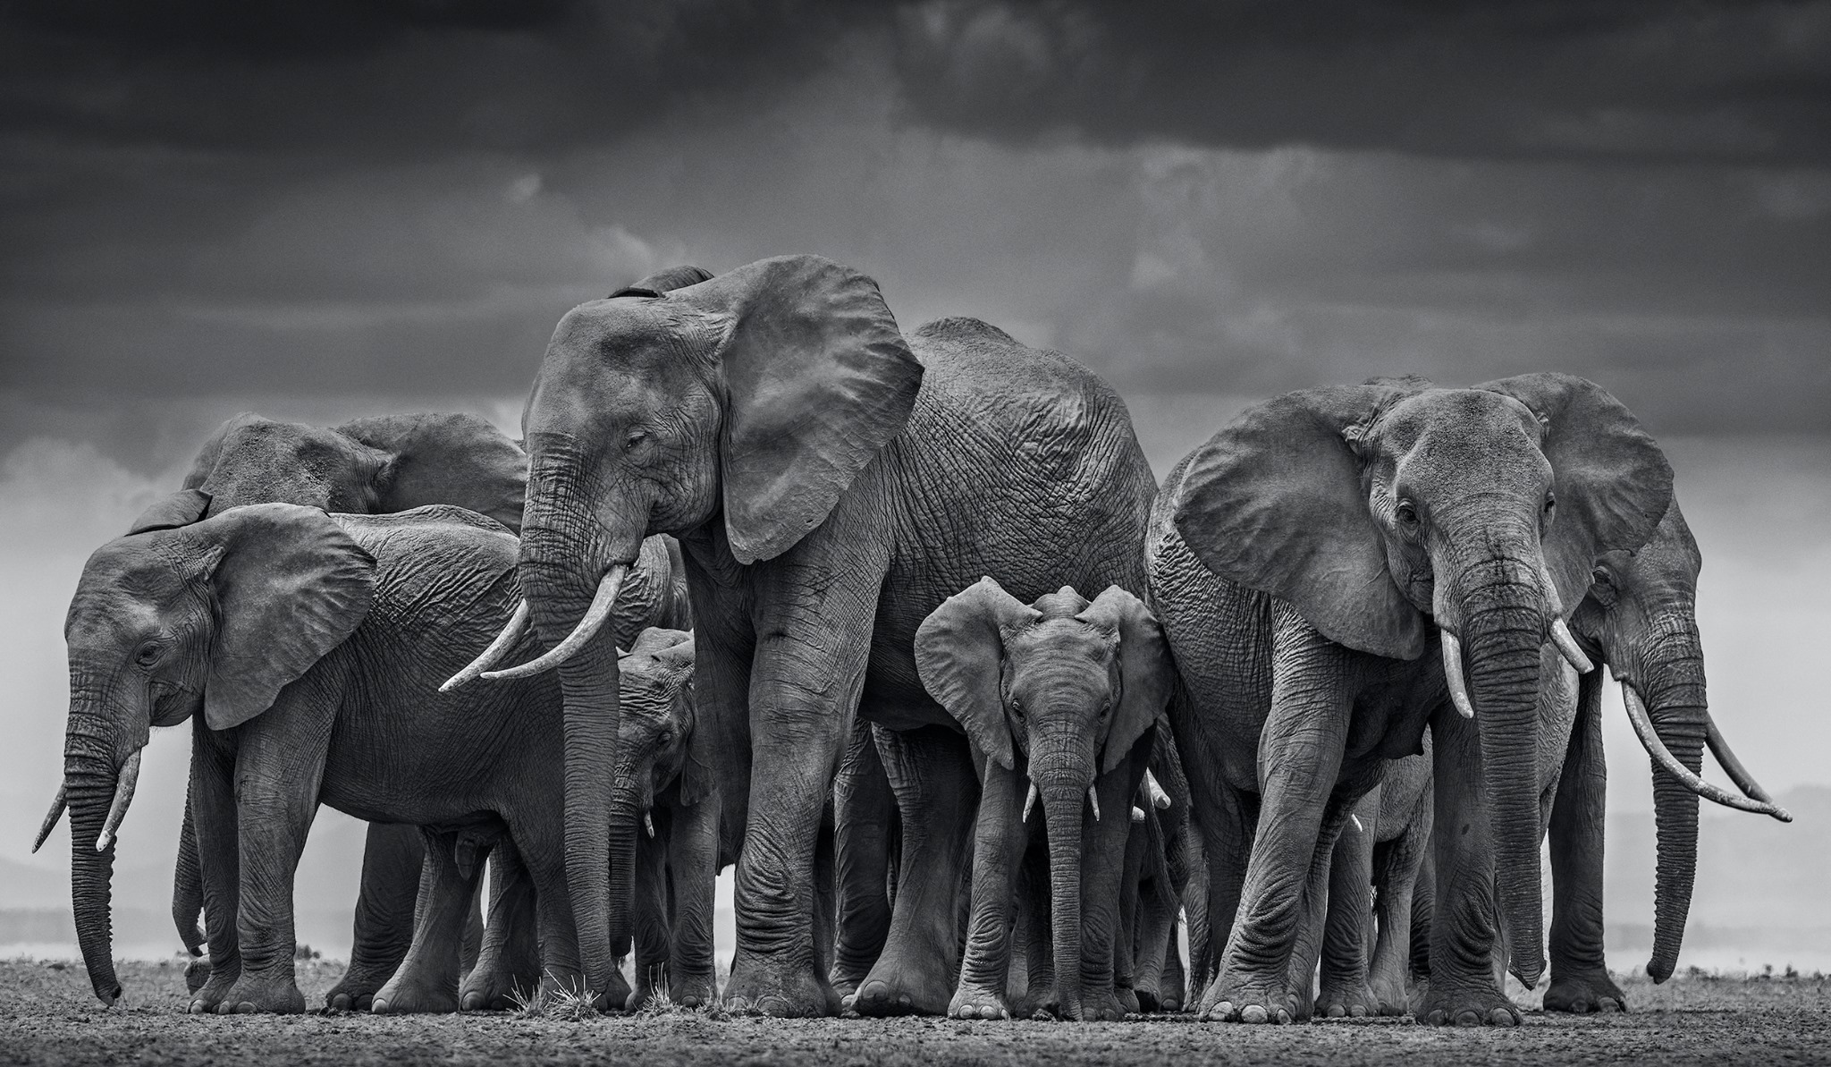
THE ELEPHANT STORY
It's about female elephants. You know, as all good stories begin. See, in the wild, when a mama elephant is giving birth, all the other female elephants in the herd back around her in formation. They close ranks so that the delivering mama cannot even be seen in the middle. They stomp and kick up dirt and soil to throw attackers off the scent and basically act like a pack of badasses.
They surround the mama and incoming baby in protection, sending a clear signal to predators that if they want to attack their friend while she is vulnerable, they'll have to get through 40 tons of female aggression first.
When the baby elephant is delivered, the sister elephants do two things: they kick sand or dirt over the newborn to protect its fragile skin from the sun, and then they all start trumpeting, a female celebration of new life, of sisterhood, of something beautiful being born in a harsh, wild world despite enemies and attackers and predators and odds.
Scientists tell us this: They normally take this formation in only two cases - under attack by predators like lions, or during the birth of a new elephant.
This is what we do, girls. When our sisters are vulnerable, when they are giving birth to new life, new ideas, new ministries, new spaces, when they are under attack, when they need their people to surround them so they can create, deliver, heal, recover...we get in formation. We close ranks and literally have each others' backs. You want to mess with our sis? Come through us first. Good luck.
https://www.youtube.com/watch?v=0SauNUEw_OU&app=desktop

