Slide 1

TITLE IX and Athletics
Dr. Amy Wilson, Managing Director of Inclusion
May 2023

Slide 2
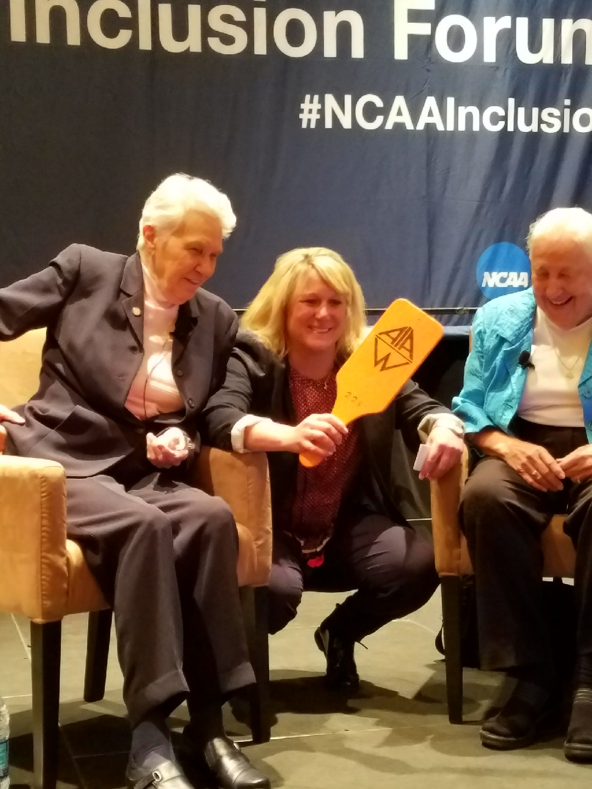
Title IX Pioneers/My Mentors: Dr. Christine Grant and Dr. Charlotte West
Gratitude

Slide 3
NCAA Office of Inclusion
The NCAA office of inclusion advances diversity, equity and inclusion in college athletics for over 1,100 member schools and athletics conferences and the NCAA national office. The office supports student-athletes and individuals who teach and lead across the core areas of disability, international, LGBTQ, race/ethnicity and women.
Inclusion - NCAA.org
Inclusion Forum – Annual Signature Program

Slide 4
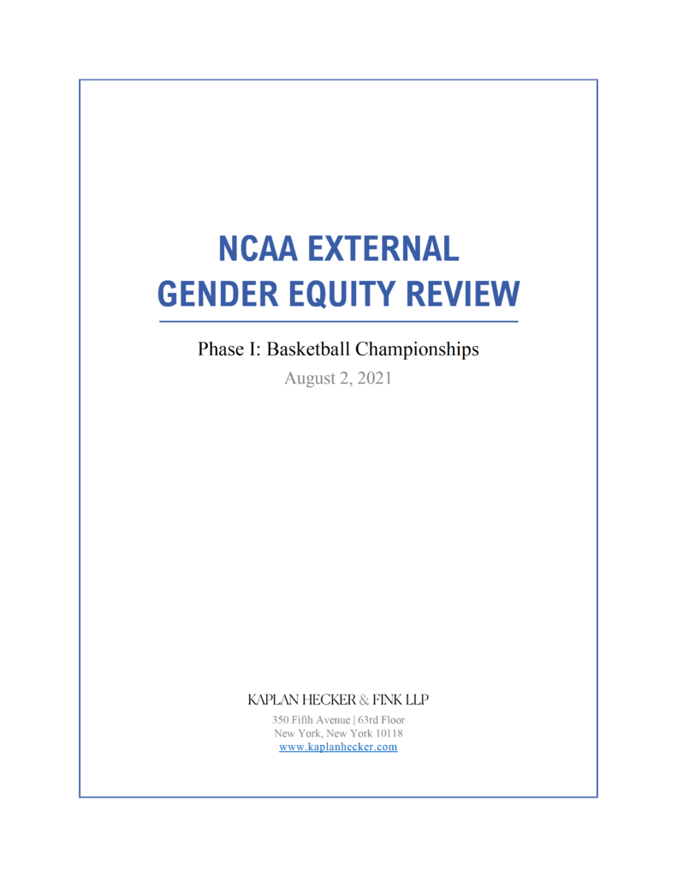

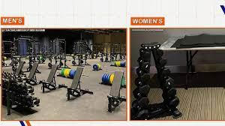
NCAA and Gender Equity

Slide 5
Plan for Today
Share and Learn about Title IX.
“Refresh” understanding of Title IX’s application to athletics.
Action Items for Title IX and equity.

Slide 6
Partner Share!
How has your campus, athletics department, team, etc. celebrated and commemorated Title IX’s 50th anniversary?
TRUE? OR FALSE?
Title IX has been widely supported since it was signed into law on June 23, 1972.
Title IX covers 3 main areas.
Men hold approximately 75% of athletics director and head coaching positions at NCAA membership schools.

Slide 7
The Text of Title IX
No person in the United States, shall on the basis of sex, be excluded from participation in, be denied the benefits of, or be subjected to discrimination under any educational program or activity receiving federal financial assistance.

Slide 8
10 Areas Covered by Title IX
Access to Higher Education
Athletics
Career Education
Education for Pregnant and Parenting Teens
Employment
Learning Environment
Math and Science
Sexual Harassment
Standardized Testing
Technology

Slide 9
History of Title IX and Athletics:
A Roller Coaster!
1970s: Amazing participation growth for girls and women AND NCAA fights Title IX and engages in hostile takeover of Association for Intercollegiate Athletics (AIAW)
1980s: Supreme Court Case Grove City v. Bell results in no Title IX for athletics for half of the decade. Athletics departments merged.
2000s: President Bush’s Commission on Opportunity in Athletics poses challenge to Title IX.

Slide 10
Head Coaches by Gender

Slide 12
Title IX and Athletics
Financial Aid/Scholarships
Effective Accommodation of Students’ Interests and Abilities/Participation
Benefits, Opportunities, and Treatment

Slide 13
A. Financial Assistance
Total amount of athletic aid must be substantially proportionate to the ratio of male and female athletes.
Example:
  45% of athletes are female, then 45% of scholarship money should be awarded to female athletes
  Not applicable at D-III level where no athletic scholarships granted.

Slide 14
B. Effective Accommodation of Students’ Interests and Abilities
“Three-Prong Test”
1. Opportunities for males and females proportional to enrollments.
2. History and continuing practice of program expansion responsive to the developing interests and abilities of the underrepresented sex.
3. Interests and abilities of underrepresented sex have been fully and effectively accommodated by the present program.

Slide 15
C. Benefits, Opportunities and Treatment
Equipment and supplies
Scheduling of practice and competition
Travel and per diem
Opportunities for coaching and academic tutors
Assignment and compensation of coaches and academic tutors
Locker room, practice and competitive facilities
Medical and training facilities and services
Housing and dining facilities and services
Publicity
Support services
Recruitment of student-athletes

Slide 16
Title Ix and athletics
A. Participation: The Three Prongs (must comply with one)
1. Opportunities for males and females proportional to enrollments.
2. History and continuing practice of program expansion responsive to the developing interests and abilities of the underrepresented sex.
3. Interests and abilities of underrepresented sex have been fully and effectively accommodated by the present program.
B. Financial Assistance/Scholarships (1%)
C. Treatment/Benefits (The Laundry List)
1. Compare overall men’s and women’s sports programs.
2. Focus on student-athlete impact. (uniform example)
3. Title IX does not care from where the money comes!

Slide 17
Call to Action!
ENGAGE AND LEARN!
  WeCOACH Membership Benefits!
  Equity in Athletics Disclosure Act
  Tucker Center for Research on Girls and Women in Sport
  Women’s Sports Foundation
  NCAA: Title IX’s 50th Anniversary
  Office for Civil Rights/Dept. of Education
    Title IX and Athletic Opportunities in Colleges and Universities A Resource for Students, Coaches, Athletic Directors, and School Communities (PDF) (ed.gov)
  NCAA Inclusion Forum
  Be Prepared to Speak/Act when Title IX is challenged.

Slide 18
Call to Action!
TEACH!
  About your school’s/conference’s pioneers and trailblazers.
  National Girls and Women in Sports Day (early Feb.)
  Title IX’s Anniversary—June 23
      ESPN+ Fifty/50 Collection
      Title IX: 37 Words that Changed America | TBS.com (Candace Parker)
      Unshakeable Belief – The Dr. Christine Grant Story – University of Iowa Athletics (hawkeyesports.com)
MENTOR AND INSPIRE!
  Engage Student-Athletes about Careers in Athletics.
  Support a Colleague’s Efforts to Achieve a Goal.
\

Slide 19

Call to Action!!
\

Slide 20

Questions/comments?
THANK YOU!
Contact info:
Dr. Amy Wilson, Managing Director of Inclusion
awilson@ncaa.org
@AmySWilson20

